Slide 1


Slide 2
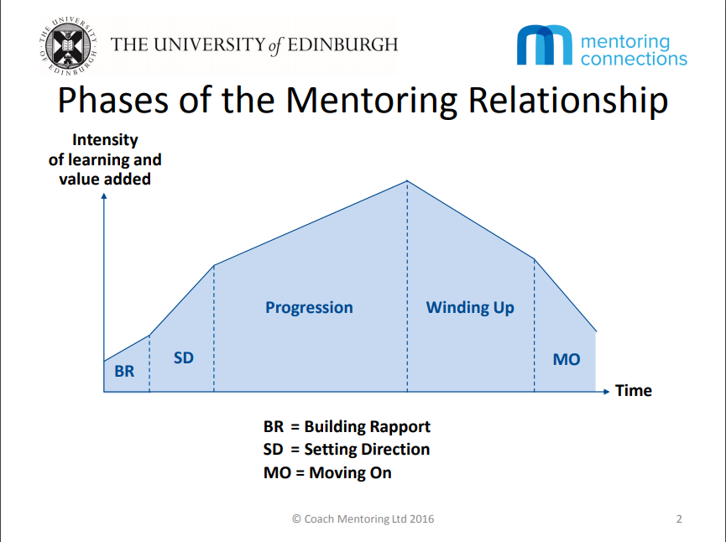

Slide 3


Slide 4
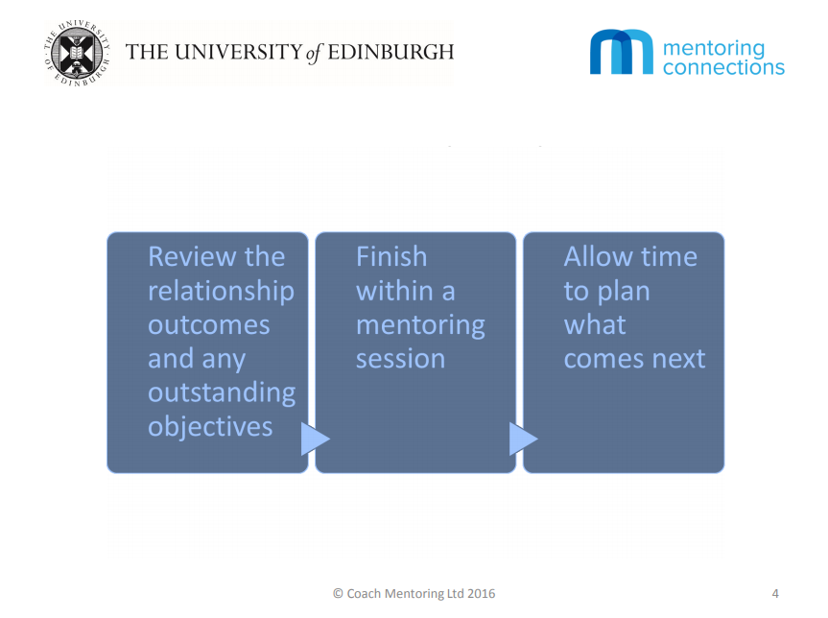

Slide 5
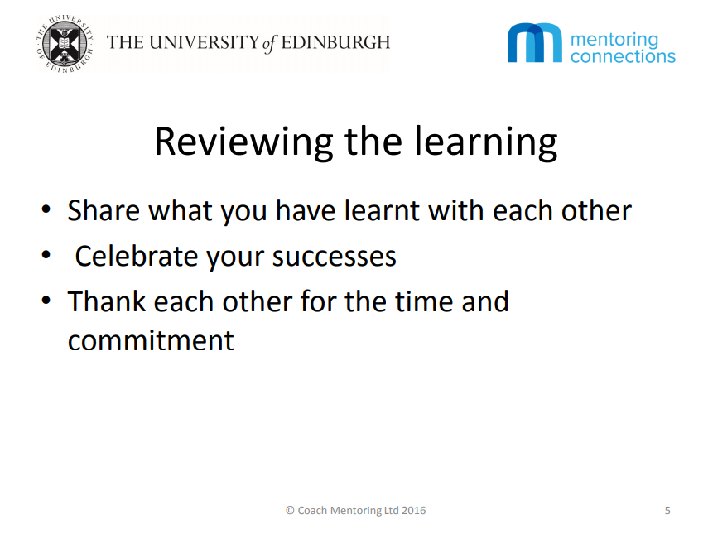

Slide 6
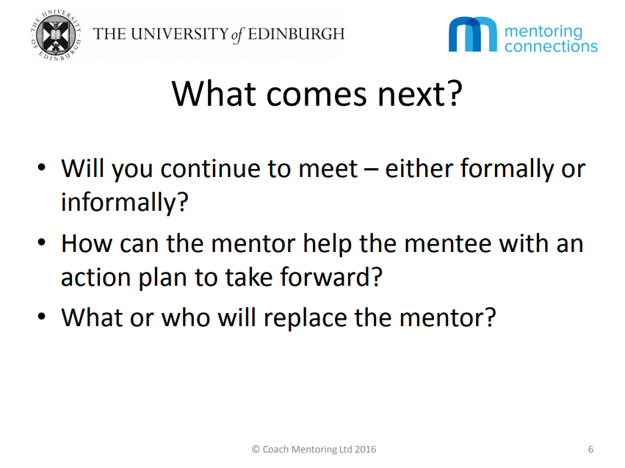

Slide 7


Slide 8


Get in touch with any questions:
LearningandDevelopment@ed.ac.uk

